Slide 1
Manufacturing Performance Analysis: November 2015
Leveraging Data to Drive Operational Efficiency
Notes:
Good morning. This analysis focuses on our manufacturing data from November 2015. Our goal is to move beyond simply reporting numbers and use data to pinpoint the exact sources of production waste and operational bottlenecks.

Slide 2
Data Scope and Project Objective
Data Source: Production log data for one month (November 2015).
Resources: Tracking 117 Employees and 87 Machines.
Limitation: Only one month of data is available, preventing long-term trend analysis.
Objective:
Primary Goal: Immediately reduce the overall Wastage Percentage.
Secondary Goal: Identify and address the top contributors to rejection, focusing exclusively on the high-risk Woven Label's process.
Notes:
We analyzed highly detailed production data across all our resources. The key objective is clear: Reduce our total Wastage %. Given the single-month constraint, we had to focus on granular details to quickly identify actionable root causes.

Slide 3
KPI Performance & Core Insights
KPI Card | Value
Total Manufactured Qty | 86.77 Million
Total Rejected Qty | 524.73 Thousand
Wastage % | 0.61%
Total Employees/Machines | 117 / 87
Core Insights:
Baseline: The 0.61% wastage is our current performance baseline.
Impact: This rejection volume represents a significant loss in material and labor costs for the month.
Urgency: The overwhelming majority of this waste is driven by a single product line, which requires immediate attention.
Notes:
Our current wastage stands at 0.61%. This is our baseline and represents a significant recoverable loss. Every analysis that follows is focused on how to reduce this single percentage point.

Slide 4
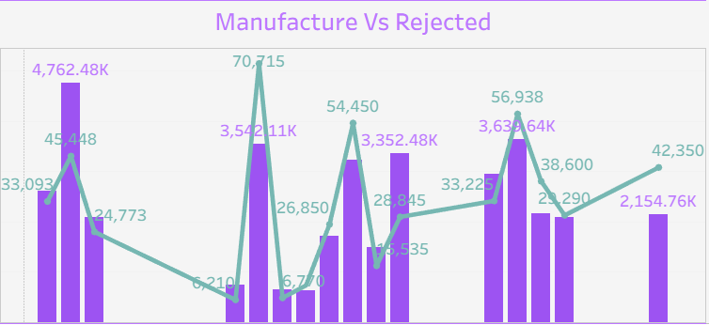
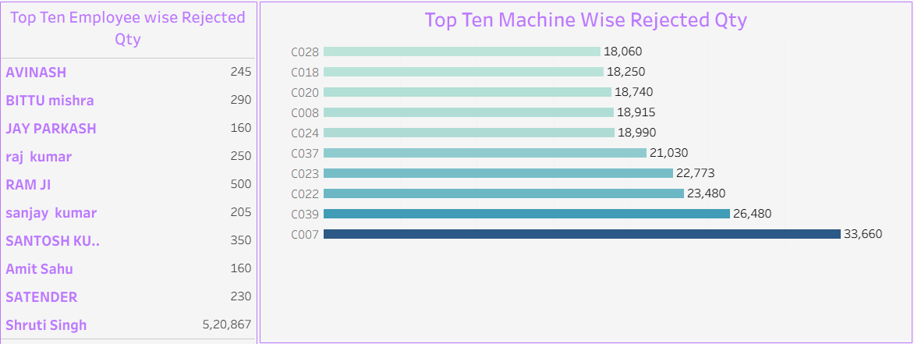
Daily Trends and Root Cause Isolation
Process Spikes: Rejections peaked significantly on November 09, indicating a specific single-day failure event.
Personnel: Employees Ram Ji and Shruti Singh consistently contribute highly to waste in the Woven Label's area.
Equipment: Machine MC050 / C007 is responsible for the largest single share of waste and is our top maintenance priority.
Notes:
We immediately isolated the high-risk factors. The daily trend clearly shows critical failure days, like November 09. The Top 5 charts pinpoint the equipment and personnel: we must focus our immediate efforts on Pooja Verma, Shruti Singh, and Machine MC050.

Slide 5
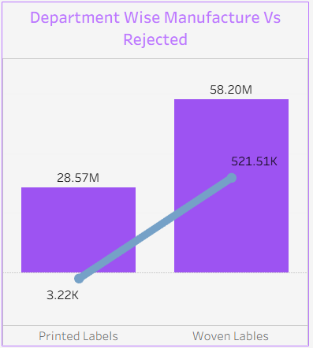
Identifying the Source of Waste: Woven Label's vs. Printed Label's
Product Type | Manufactured Qty | Rejected Qty | Wastage %
Woven Label's | 58.20 Million | 521.51 Thousand | 0.904%
Printed Label's | 28.57 Million | 3.22 Thousand | 0.011%
Conclusion:
The overall wastage of 0.61% is almost entirely attributable to the Woven Label's Production process.
The Printed Label's process is highly efficient and serves as an internal benchmark.
Notes:
This is the most critical insight. Our overall efficiency is masked by this huge disparity. The Woven Label's Production process is operating at a near 1% waste rate, while Printed Label's are highly efficient. All our resources must be directed toward fixing the Woven Label's line."

Slide 6
Project Challenges and Key Learnings
Challenges:
Data Volume: Only one month of data was available, preventing long-term trend analysis.
Data Granularity: Detailed process-step timing was not consistently available, limiting deep cycle time optimization.
Learnings:
High-Impact Isolation: Breaking data down by product type (Woven vs. Printed) proved the fastest way to isolate the core problem.
Efficiency Metric: The 'Wastage %' calculation is the most effective single metric for rapid comparison and benchmarking.
Notes:
While the one-month data limit was a challenge, we adapted by focusing on daily variance and granular segmentation. Our biggest learning is the power of isolating machine-specific rejection data—this instantly created our maintenance plan.

Slide 7
Prioritized Action Plan and Recommendations (Targeting Woven Label's)
Immediate Action Plan:
High-Risk Machine Intervention: Schedule a full calibration and service check for Machine MC050 / C007 within 48 hours.
Targeted Retraining: Implement mandatory refresher training for Pooja Verma and Shruti Singh focused on Woven Label's quality checks.
Process Audit: Launch an immediate process audit on the Woven Label's operational procedures using the high-performing Printed Label's process as the standard.
Long-Term Goal:
Reduce the Woven Label's wastage rate from 0.90% to 0.40% next month
Notes:
Our recommendations are simple and prioritized. We must fix the high-risk equipment, coach the personnel, and audit the Woven Label's process. Our immediate goal is to reduce that high Woven Label's wastage rate to 0.40% next month.

Slide 8
Conclusion & Next Steps
Summary:
The analysis successfully achieved its objective by pinpointing that the Woven Label's Production process is the overwhelming source of waste.
We have a clear, data-driven plan for operational improvement.
Next Steps:
Track performance against the recommendations over the next 30 days.
Begin collecting historical data to enable future Year-over-Year (YoY) analysis.
Notes:
This is the dashboard—the single source of truth for our performance. It allows us to hold data-driven conversations. Thank you for your time. I am now open for questions on the data or the proposed action plan.

Slide 9
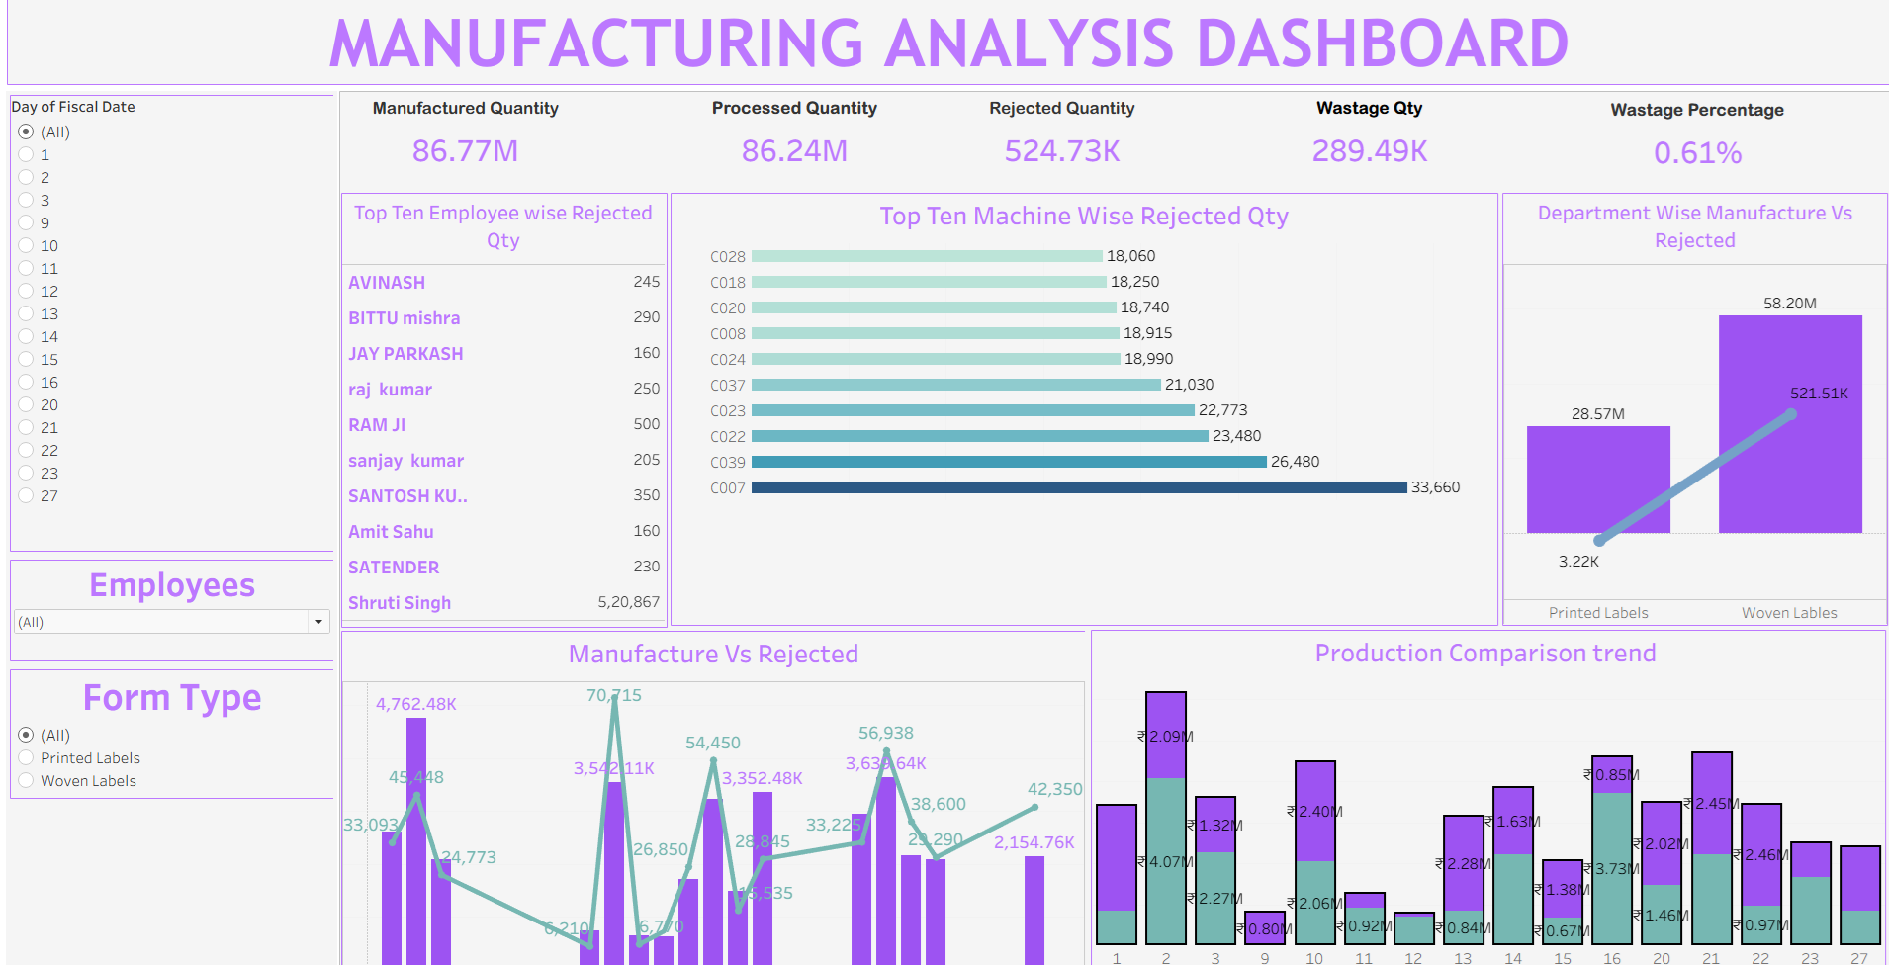
Thank You

